Slide 1

Risk Management
Expect the Unexpected!

Slide 2
Risk
What is it? A risk is a potential problem for a software project—it might happen, it might not. But, regardless of the outcome, it’s a really good idea to identify it, assess its probability of occurrence, estimate its impact, and establish a contingency plan.
It can also be defined in the following way “ An uncertainty that can positively or negatively impact project objectives.”
A risk is an unforeseen event with probability that some adverse circumstance can occur.
Project risks affect schedule or resources
Product risks affect the quality or performance of the software being developed
Business risks affect the organisation developing or procuring the software
Who does it? Everyone involved in the software process— managers, software engineers, and other stakeholders—participates in risk analysis and management.

Slide 3
Importance
Understanding the risks and taking proactive measures to avoid or manage them—is a key element of good software project management.
A project without a risk management plan can find itself in serious trouble that could have been avoided if the project team had addressed its development risks more systematically and followed its plans.

Slide 4
Importance of Risk Management
IT projects face high risks due to:
Rapidly changing technologies.
Ambiguous user requirements.
Complex integrations.
Effective risk management improves:
Project success rates.
Stakeholder confidence.
Cost and time efficiency.

Slide 5
Example
A
Project Failures due to poor Risk Management
Challenger Space Shuttle Disaster (1986)
Intel Pentium Processor Bug (1994)
B

Slide 6
Types of Risks
There are various types of risks associated with software projects. Here are some common categories of risks:
Technical Risks: These risks are related to technical aspects of the software development process. They may include challenges with software architecture, integration issues, performance bottlenecks, compatibility problems, and scalability concerns.
Requirements Risks: Risks in this category arise from unclear, incomplete, or changing requirements. These risks can lead to scope creep, misunderstandings, and conflicts among stakeholders, impacting project timelines and deliverables.
Schedule and Resource Risks: Risks associated with project schedules and resource allocation involve factors such as unrealistic deadlines, inadequate resource planning, skill gaps, and unexpected changes in resource availability. These risks can result in project delays, overburdened team members, and compromised quality.

Slide 7
Organizational Risks: Organizational risks stem from factors within the organization itself, including poor communication, ineffective project management, lack of stakeholder involvement, and inadequate governance. These risks can hinder collaboration, decision-making, and overall project success.
Financial Risks: Financial risks involve budget overruns, cost estimation errors, unexpected expenses, and changes in funding or financial circumstances. Failure to manage these risks can impact the project's financial viability and the organization's financial stability.
External Risks: External risks are associated with factors outside the organization's control, such as changes in regulations, market conditions, technological advancements, and third-party dependencies. These risks can introduce uncertainties and challenges that impact project delivery.

Slide 8
Introduction to risk management
Project Risk Management
Processes for identifying, analyzing, and responding to risks.
Goal: Maximize positive risks (opportunities) and minimize negative risks (threats)
More concisely we can say;
“Project Risk Management is the process of identifying, analyzing, and responding to project risks to minimize negative outcomes and maximize opportunities.”
Software risk management is the process of identifying, assessing, and mitigating risks associated with software development and maintenance of projects.
It involves systematically identifying potential risks, analyzing their impact and likelihood, and developing strategies to minimize or eliminate them.

Slide 9
There are six major processes of project risk management:
Planning Risk Management
Identifying Risks
Performing Qualitative Risk Analysis
Performing Quantitative Risk Analysis
Planning Risk Responses
Controlling Risks

Slide 10
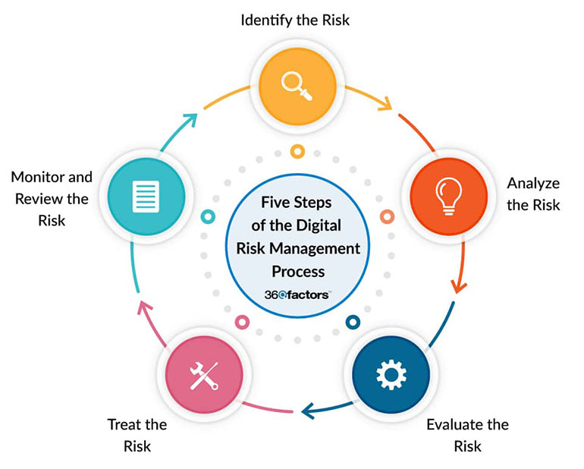

Slide 11
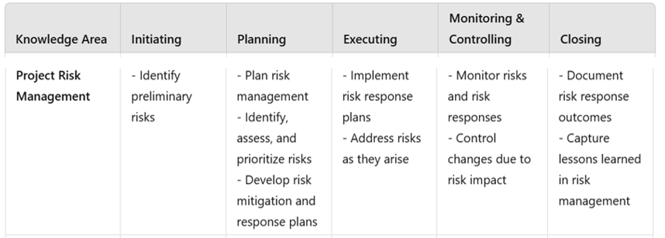
Knowledge Area to Process Mapping
CONTROL
RISK

Slide 12
Plan risk management
Plan Risk Management is the process of defining how to conduct risk management activities for a project.
Inputs:
Project Scope Statement
Cost Management plan
Schedule Management plan
Communication Management plan
Enterprise Environmental Factors
Organizational Process Assets
Tools And Techniques
Data Analysis
Meetings
Outputs:
Risk management plan

Slide 13
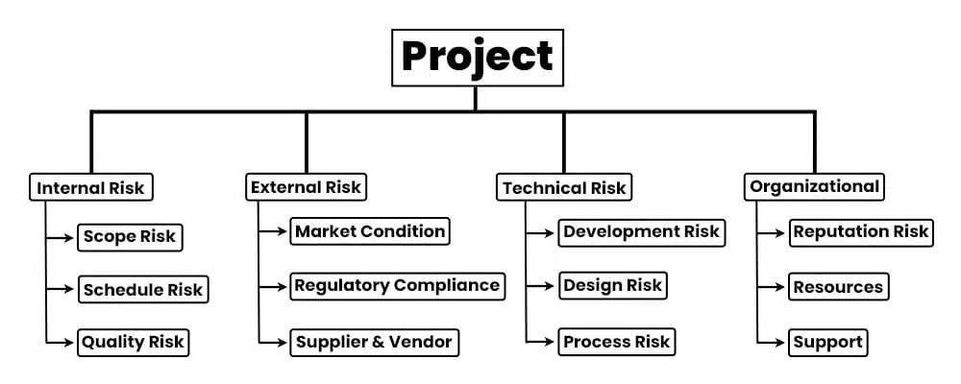
Example of risk break down structure

Slide 14
Identify Risks
Identify risks is the process of determining which risk may affect the project and documenting their characteristics

Slide 15
Identify Risks
Inputs:
Risk management plan
Activity cost estimates
Agreement
Organizational process assets
Project Documents
Tools and Techniques:
Data gathering
Prompt List
Outputs:
Risk register

Slide 16
Perform Qualitative risk analysis
Perform Qualitative risk analysis is the process of prioritizing risks for further analysis which involves combing their probabilities of occurrence and impact.

Slide 17
Perform Qualitative risk analysis
Inputs:
Risk Register
Risk Management Plan
Project Scope Statement
Organizational Process Assets
Tools And Techniques
Risk Probability and impact assessment
Probability and impact matrix
Risk data quality assessment
Risk categorization
Expert judgement
Outputs:
Risk register updates

Slide 18
Risk probability and impact assessment
Assess risk by:
Probability : Likelihood of occurrence
Impact : Effect on project objectives
risk6 | risk9 | risk1 risk4
risk3 risk7 | risk2 risk5 risk11
 | Risk8 risk10 | risk12
High
Probability
Medium
Low
High
Medium
Low
Impact

Slide 19
Perform quantitative risk analysis
Perform quantitative risk analysis is the process of analyzing numerically the effects of the analyzed risks on the project objectives.
It provides quantitative approach of decision making when risks are involved.

Slide 20
Performing Quantitative Risk Analysis Tools and Techniques
Data Gathering & Representation:
Interviewing: Expert insights for estimating risks.
Historical Data: Use past projects to predict outcomes.
Quantitative Risk Modeling:
Monte Carlo Simulation: Simulates multiple scenarios to predict outcomes.
Decision Tree Analysis: Models decisions, assigning probabilities and values.
Sensitivity Analysis: Identifies key risks with the highest impact.
Expected Monetary Value (EMV):
Formula: EMV = Probability × Impact
Example: 20% chance of risk, $50,000 impact = $10,000 EMV.
Notes:
Decision trees simplify complex decisions. They integrate probabilities and financial outcomes. Useful in making data-driven, risk-informed choices.
Monte Carlo Simulation is a quantitative risk analysis technique that uses computational algorithms to model the impact of risk and uncertainty on project outcomes.
How It Works:
Inputs are defined with possible ranges for uncertain variables (e.g., cost, schedule).
Software runs thousands of simulations using random values within these ranges.
Outputs include a probability distribution for outcomes (e.g., the chance of meeting a deadline or staying under budget)
Sensitivity Analysis: Sensitivity Analysis examines how changes in individual risk variables affect project objectives like cost or schedule.
It prioritizes risk responses by focusing on the most critical factors affecting project outcomes.
EMV helps in comparing risks and deciding on cost-effective responses, ensuring resources are allocated wisely.

Slide 21
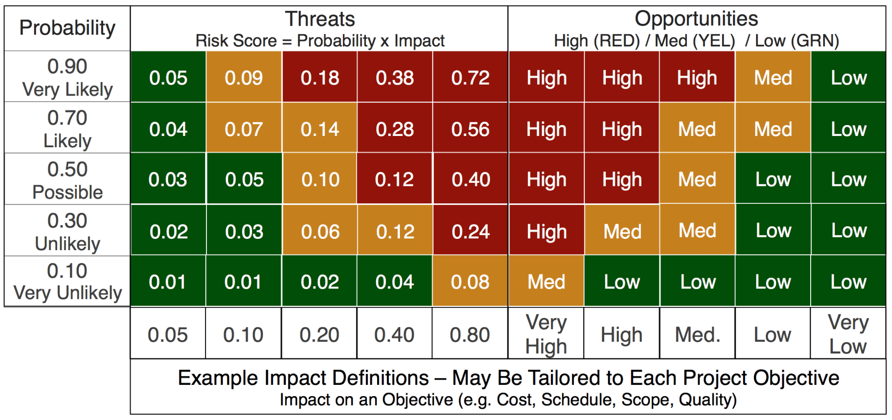
Expected monetary value (emv)

Slide 22
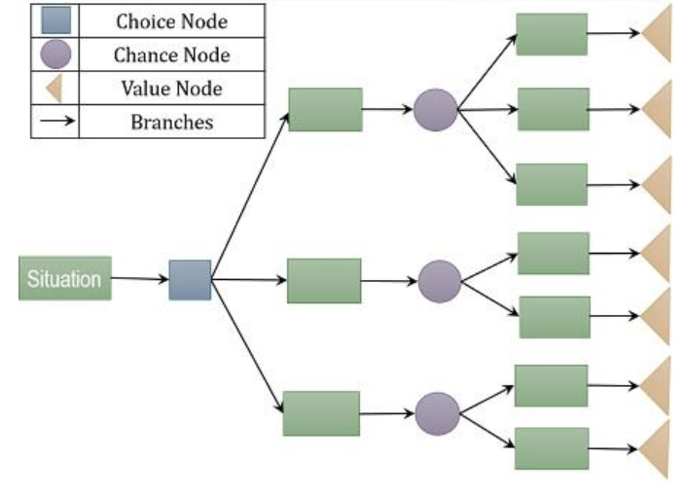
Decision Trees
Notes:
Decision trees simplify complex decisions.
Useful in making data-driven, risk-informed choices.

Slide 23
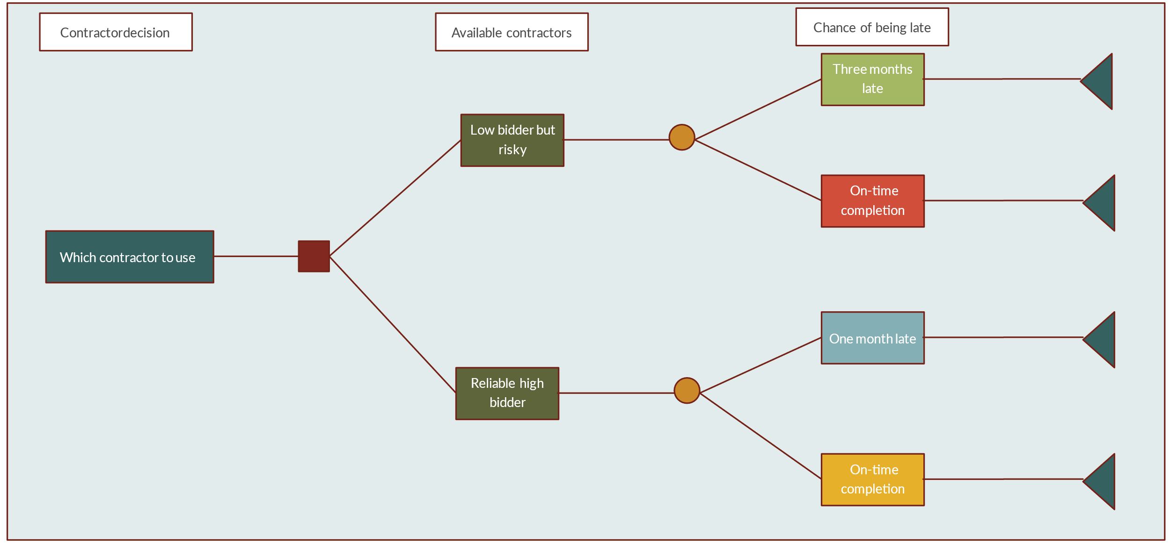
Perform Quantitative risk analysis- decision trees
Decision Node
Chance Node
End of branch

Slide 24
Plan risk responses
The process of developing options and actions for opportunities and threats.
Inputs:
Risk Register
Risk Management Plan
Tools and Techniques
Contingency Response Strategies
Outputs
Risk register updates
Risk related contracts
Project management updates
Project document update

Slide 25
Plan risk responses
Shift risk to another party (e.g., insurance).
Strategies for Negative Risk
Avoidance: Eliminate the risk
Mitigation: Reduce probability or impact
Acceptance: Acknowledge risk with no action
Transfer: Shift risk to another party (e.g., insurance)
Strategies for Positive Risk
Exploit: Ensure the opportunity occurs
Share: Partner to enhance the chance of success
Enhance: Increase probability or impact

Slide 26
Control risks
Monitor and adjust risk responses
Update risk register regularly
Track performance through:
Risk audits
Variance and trend analysis
Communicate changes to stakeholders

Slide 27
Tools and Techniques
Risk Register: Document containing identified risks, their assessments, and planned responses.
Risk Breakdown Structure (RBS): Categorizes risks into a hierarchy.
Software Tools: Risk tracking and simulations.

Slide 28
Conclusion
Risk management isn’t just a task—it’s a mindset. By transforming uncertainties into opportunities, teams pave the way for success.
Quote:
“Failing to plan is planning to fail.”
Key Takeaways:
Risk management is integral to project success.
Proactive identification and planning minimize disruptions.
Continuous monitoring ensures effective risk response.
With the right tools and approach, risks become stepping stones to innovation and growth.
CONTROL
RISK

Slide 29
Case study
Scenario:
A health-tech startup is developing "MediTrack+", a cross-platform (iOS/Android) mobile app that allows users to track their chronic health conditions (e.g., diabetes, hypertension, asthma). The app enables users to log daily vitals, receive medication reminders, share health reports with doctors, and get AI-generated health insights.
The team also aims to integrate with wearable devices (like Fitbit, Apple Watch) and support telemedicine chat/video consultations through third-party APIs.

Slide 30
Key Details:
Team Composition: 7 people — 4 developers, 1 product manager, 1 UI/UX designer, 1 part-time medical advisor.
Target Launch: 9 months from project start.
Key Features:
Daily health tracking (blood pressure, glucose, heart rate, etc.).
Smart medication reminders and refill alerts.
AI-based health insights from user data trends.
Doctor-patient messaging and video consults (via third-party API).
PDF report generation for medical check-ups.
Data sync with wearables and cloud backup.
Challenges:
No previous healthcare app experience.
Requires HIPAA/GDPR compliance.
Must implement secure authentication and encryption.
Budget constraints: limited testing devices, minimal marketing.
Planning to launch a closed beta in 5 months.

Slide 31
Risk Type | Examples | Justification
Technical | Wearable device integration; AI health insights | Integrating with multiple wearable APIs can be complex. Ensuring accurate AI recommendations requires data quality and medical validation.
Schedule | 5-month beta, 9-month full launch | Tight timeline for a healthcare app with compliance and security constraints.
Security | Data privacy, secure messaging, authentication | Medical data is sensitive; app must ensure encryption, secure login (2FA), and data protection.
Regulatory | HIPAA/GDPR compliance | Legal consequences for mishandling data. Requires thorough documentation and audits.
Operational | Lack of healthcare domain experience | Developers may misinterpret medical needs or standards. The part-time advisor may not be enough.
Resource | Small team, budget constraints | Limited testing devices, minimal QA budget, and small dev team may delay feature completion.
Market | Competing with established apps | Competing against major players (e.g., MyChart, Apple Health) requires unique value or partnerships.

